Slide 1
Notes:
1
1

Slide 2
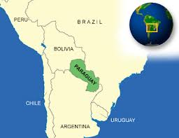
PARAGUAY
Land of Opportunities
Notes:
2
2

Slide 3
H.E. Horacio Cartes
President of the Republic of Paraguay
Notes:
3
3

Slide 4
¨A World Class food producer; open and connected to the world; with high rates of development, rule of law and public safety; environmentally sustainable; with women inclusion and young entrepreneurship as trademark; and a Government that promotes solidarity, transparency and zero tolerance to corruption¨
Notes:
4
4

Slide 5
MACROECONOMIC STABILITY
Notes:
5
5

Slide 6
GDP Growth (%)
Source: Central Bank of Paraguay - www.bcp.gov.py & IMF
Notes:
6
6

Slide 7
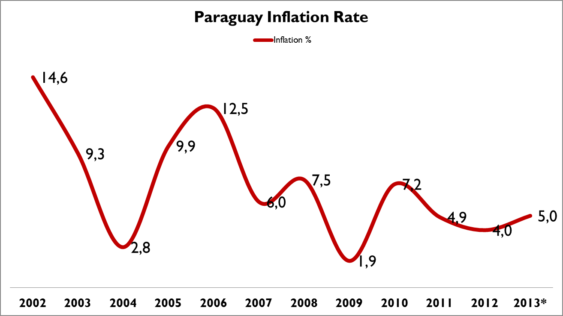
Price Stability
Source: Central Bank of Paraguay - www.bcp.gov.py *Projection for 2013 according BCP Preliminary Balance
Notes:
7
7

Slide 8
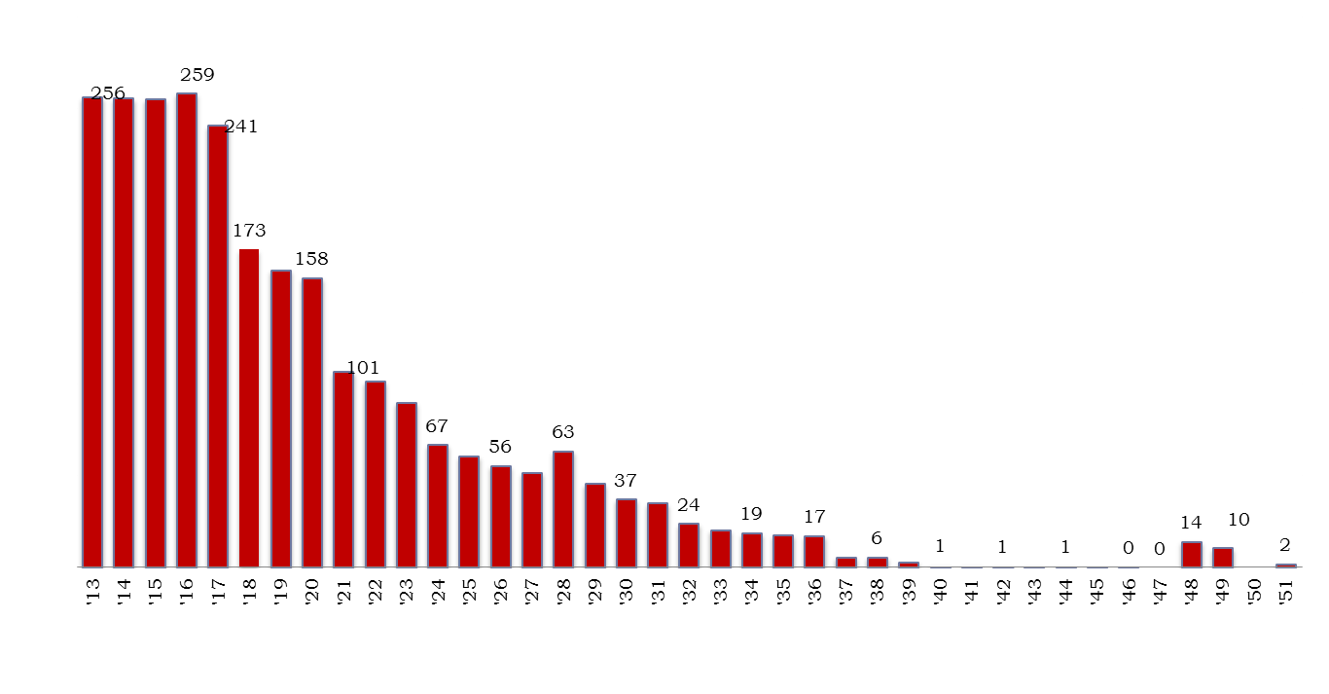
Sovereign Debt Schedule (Principal + Interest U$S MM)
Source: Ministry of Finance (www.hacienda.gov.py)
Notes:
8
8

Slide 9
Sovereign Risk Profile
Source: Central Bank of Paraguay, EIU, Moody’s, S&P. (1) Foreign Currency Long Term rating
Notes:
9
9

Slide 10
Economic Freedom
Economic Freedom Index – The Heritage Foundation
COUNTRY | RANKING
Paraguay | 80
Brazil | 100
Argentina | 160
Bolivia | 156
Ecuador | 159
Venezuela | 174
Source: The Heritage Foundation (www.heritage.org)
Notes:
10
10

Slide 11
OPPORTUNITIES
Notes:
11
11

Slide 12
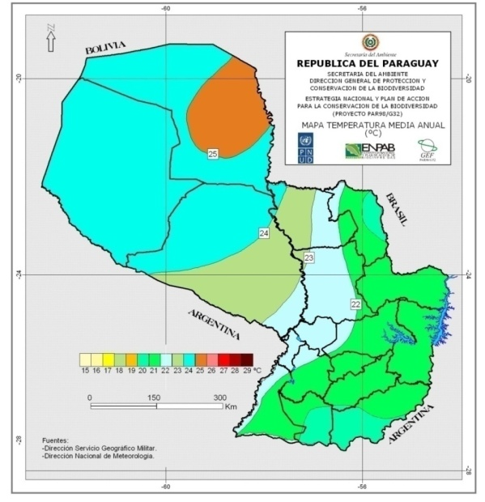
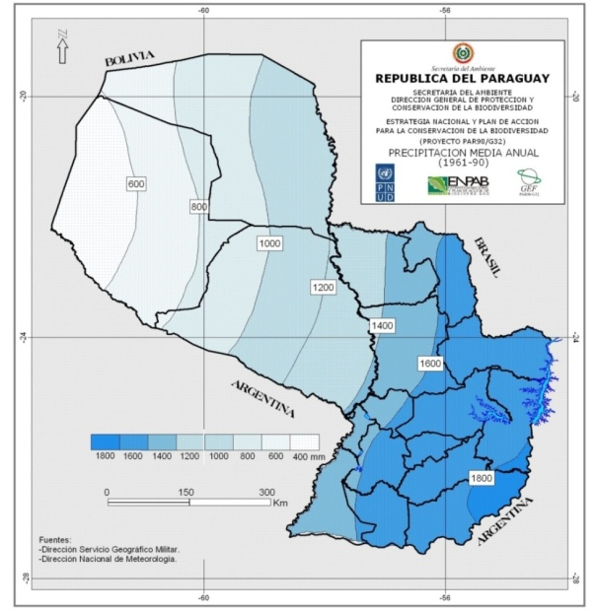
Ideal Natural Conditions
Average yearly temperature:
28 Cº
Average yearly rainfall:
1.200 mm.
Source: Instituto Geográfico Militar – IGM & DGEEC
Notes:
12
12

Slide 13
Business Opportunities
Commercial Irrigation ⇒ PPP ⇒ participation of construction, supplier and financing companies.
Small Farm Irrigation⇒ transfers from Central and Local Governments ⇒ participation of credit unions, guilds, supplier and companies with Social Responsibility.
Agricultural Production ⇒ production of grains and meat ⇒ silo, oil, animal feed, meat packing, logistics for transport.
Notes:
13

Slide 14
OPPORTUNITIES
Labor + Clean Energy
Notes:
14

Slide 15
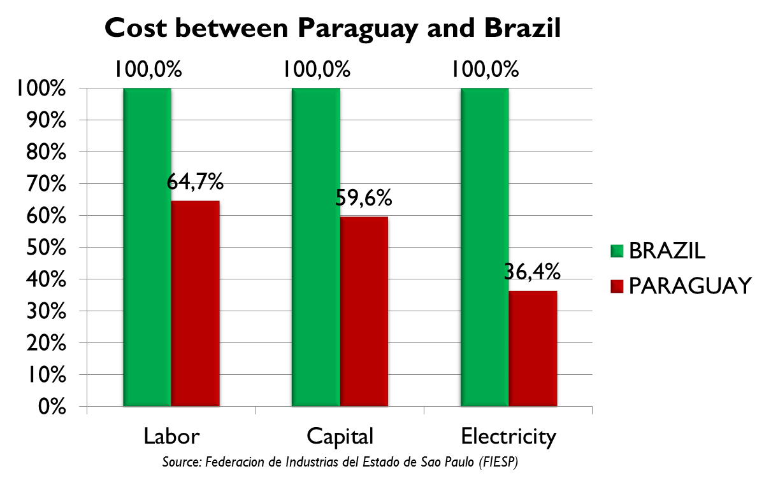
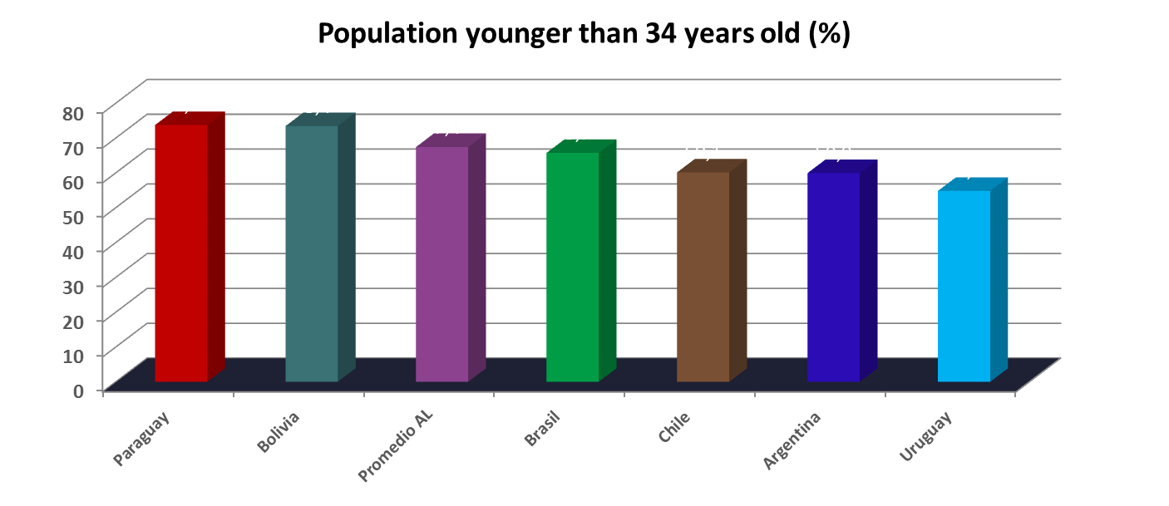
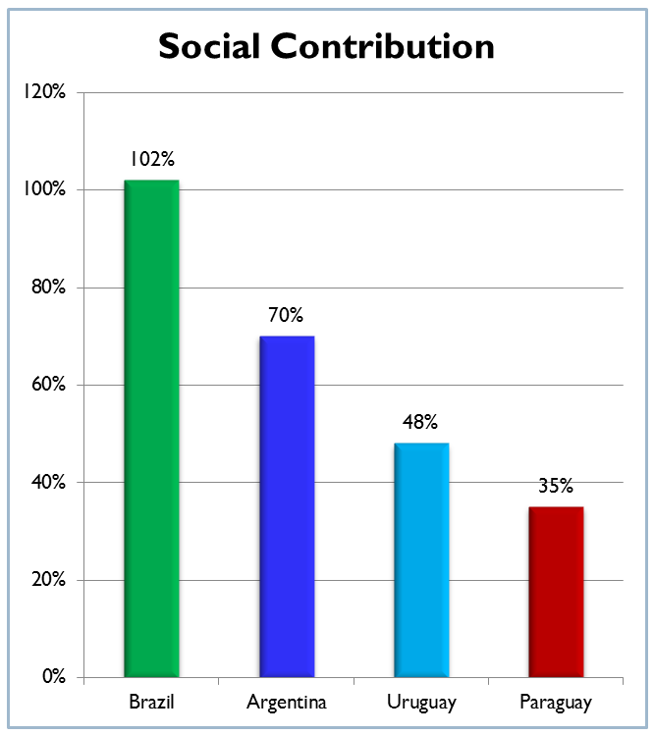
Young Labor force
Paraguay is the MERCOSUR country with a lower comparative labor cost.
- Paraguay has the youngest population in America.
- “Paraguayan labor is the best we have found so far for the company worldwide” (Ignacio Ibarra – CEO FUJIKURA)
Source: Dirección Nacional de Estadísticas, Encuestas y Censos (www.dgeec.gov.py)
Notes:
15
15

Slide 16
Business Opportunities
Competitive Labor Cost⇒ succesfull experiencies: Telecommunications, Maquila, Assembly Factories ⇒ Maquila Regime, Autoparts Regime ⇒ shipyards, autoparts, textile, food, call center, telecommunications, banks and financial institutions.
Notes:
16

Slide 17
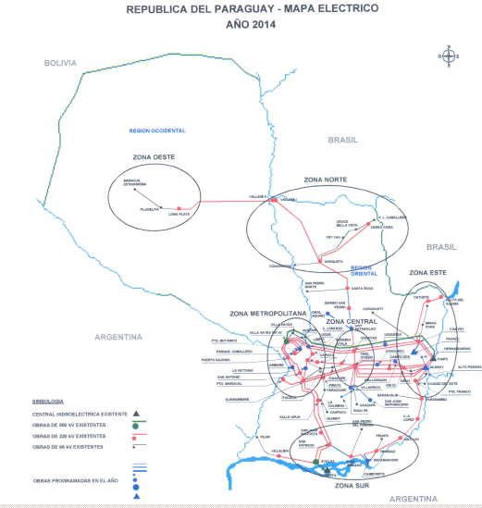
Paraguay in Numbers
Power (MVA) 220 Kv
Paraguay is the only country in south america with 1.390 Mw of power available now! and with a lower comparative cost.
30 Mw.
10 Mw.
450 Mw.
500 Mw.
300 Mw.
100 Mw.
Fuente: CIER Report about Electric Tariff in Distribution January / 2012
Notes:
17

Slide 18
Business Opportunities
Industrial complex⇒ successful stories: electrointensive industries ⇒ 60/90 Act, Autoparts Regime,High Tech Assembly Act ⇒ yarn, textile, steel mill, others.
Heavier industries ⇒shipyards, transmission towers, others.
Energy substitution⇒ items for family and industrial cooking⇒ Assembly Regime.
Notes:
18

Slide 19
OPPORTUNITIES
Preferential Access to important markets
Notes:
19

Slide 20
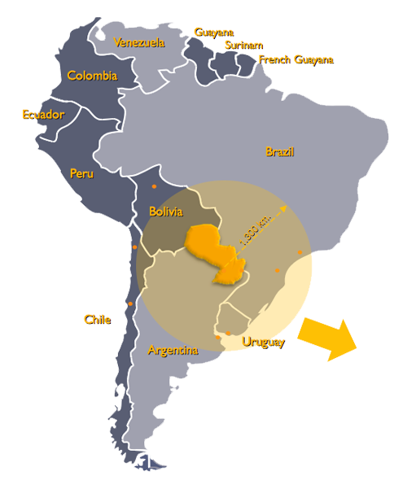
Access to Markets
Access to important markets through industrial process or value added in Paraguay
Starting in 2014, Paraguay will be the only country in MERCOSUR with preferential access to the EU – GSP+
Russia and other countries
Notes:
20

Slide 21
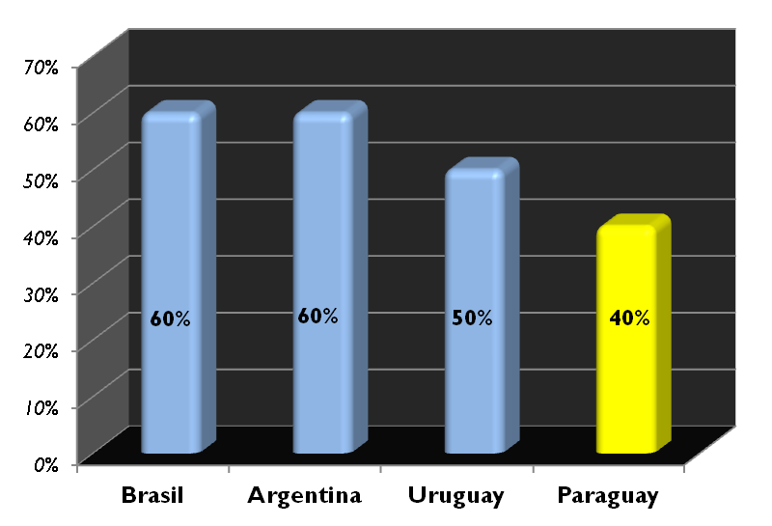
MERCOSUR PARAGUAY, Brazil, Argentina, Uruguay, Venezuela y Bolivia* and Chile, Colombia, Peru, Ecuador, Guyana y Surinam as associates countries
Necessary regional (MERCOSUR) content %
Comparative Advantages provided by the ¨Rules of Origin¨ (40% required national components and y 60% Extra Zone imported components allowed in product).

Slide 22
Russia and others Countries Generalized System of Preferences
Russia and other countries
Russian Federation: preferential access to 407 million tons of frozen beef and 400 million tons of pork.
Tariff liberalization provided by developed countries (Australia, Bulgaria, Canada, European Union, United States of America, Russian Federation, Hungary, Japan, Norway, New Zealand, Poland, Czech Republic, Slovak Republic, Switzerland and Turkey).

Slide 23
Latin American Integration Association - ALADI Argentina, Bolivia, Brazil, Chile, Colombia, Cuba, Ecuador, Mexico, Panama, Paraguay, Peru, Uruguay and Venezuela
Tariff Liberalization of approximately 90% of the regional trade.
Tariff Liberalization: Chile 2014, Bolivia 2014, Ecuador, Colombia and Venezuela 2018, Peru 2019.

Slide 24
European Union – EU Generalized System of Preferences – GSP+
GSP+ provides tariff liberalization to exporting to the European Union (28 countries) for over 6,000 products.
Some products included in the GSP+: natural juices, vegetables, tobacco, wood, vegetable oils, leather, textiles.
GSP+ extended to 2024 for Paraguay.

Slide 25
Business Opportunities
International Co. taking advantage of GSP+ and bilateral preferences to access the EU and other markets ⇒ oilseed industries , paper companies, food processing companies, others.
International Co. taking advantage of cost and Rule of Origin producing in Paraguay for other markets of MERCOSUR. ⇒ textile, plastic industry, metalwork, yarn, steel mills, others.
Notes:
25

Slide 26
OPPORTUNITIES
Competitive Tax Scheme
Notes:
26

Slide 27
Tax Scheme
TAX | PARAGUAY | ARGENTINA | URUGUAY | BRAZIL
Corporate Income Tax (*) | ≤10% | 35% | 25% | 34%
Personal Income Tax | 10% | 35% | 25% | 27,5%
Value Added Tax (VAT) | ≤10% | 21% | 23% | 25%
Paraguay has the most Competitive Tax Scheme and Fiscal Benefits in the region
Tariff for Imports of Capital Goods
(Machinery and Equipments)
0%
(VAT) Capital Goods
Acquired
(Inside or outside the country)
0%
Debt: Tax apply to remittances and payments in concept
of Capital, Interests and Commissions
(for investments over US$ 5 mill. )
0%
Revenues: Tax apply to dividends and utilities
(for investments over US$ 5 mill., for a period of 10 years)
0%
(*) Obs: if distributed internationally it may be up to 27.5%
Source: Ministerio de Hacienda (www.hacienda.gov.py)
Notes:
27

Slide 28
Business Opportunities
American and European companies moving their headquarters and cost centers to operate in the region⇒ Multinational, Banks, others.
Suppliers of goods and services for the region⇒ aerial, real estate, hotels, others.
Notes:
28

Slide 29
OPPORTUNITIES
Logistics
Top 10 producer and exporter of agricultural goods in the world
Notes:
29

Slide 30
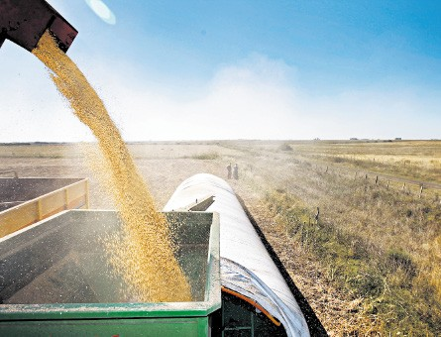
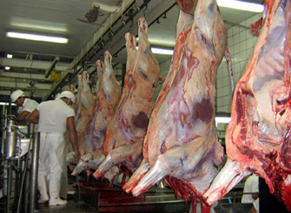
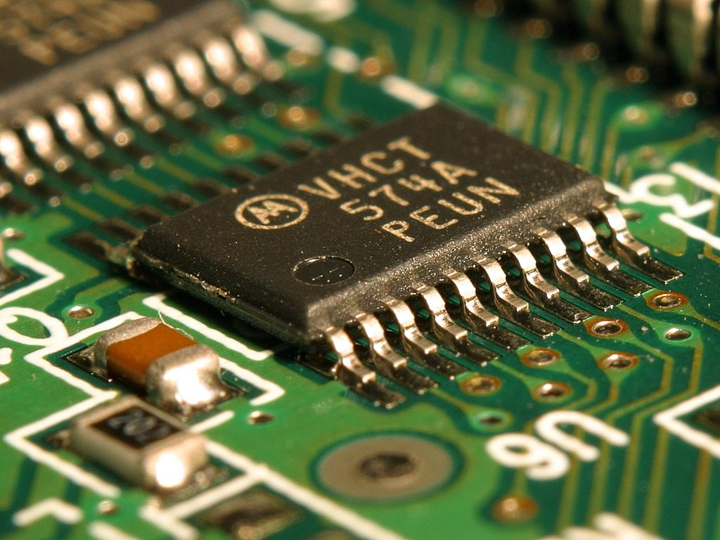
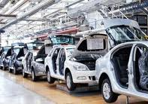
Logistics as a value added factor
P1
P4
SOYBEAN
MEAT
C6
E: enterprise
S: supplier
C: customs
M: market
D: distributor
SUPPLY CHAIN
with greater opportunities for value added in the short term
D2
C1
C5
E
C2
C8
IT
D1
C4
S5
S2
M3
C3
M1
A7
AUTOPARTS
PHARMACEUTICAL
S3
M2
Notes:
30

Slide 31
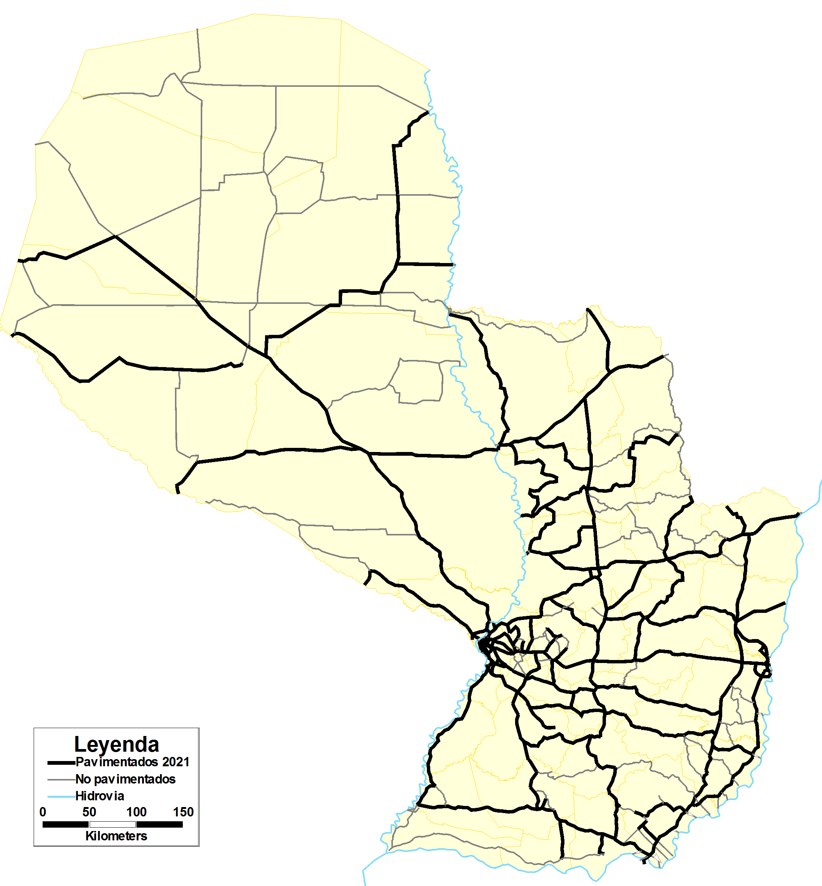
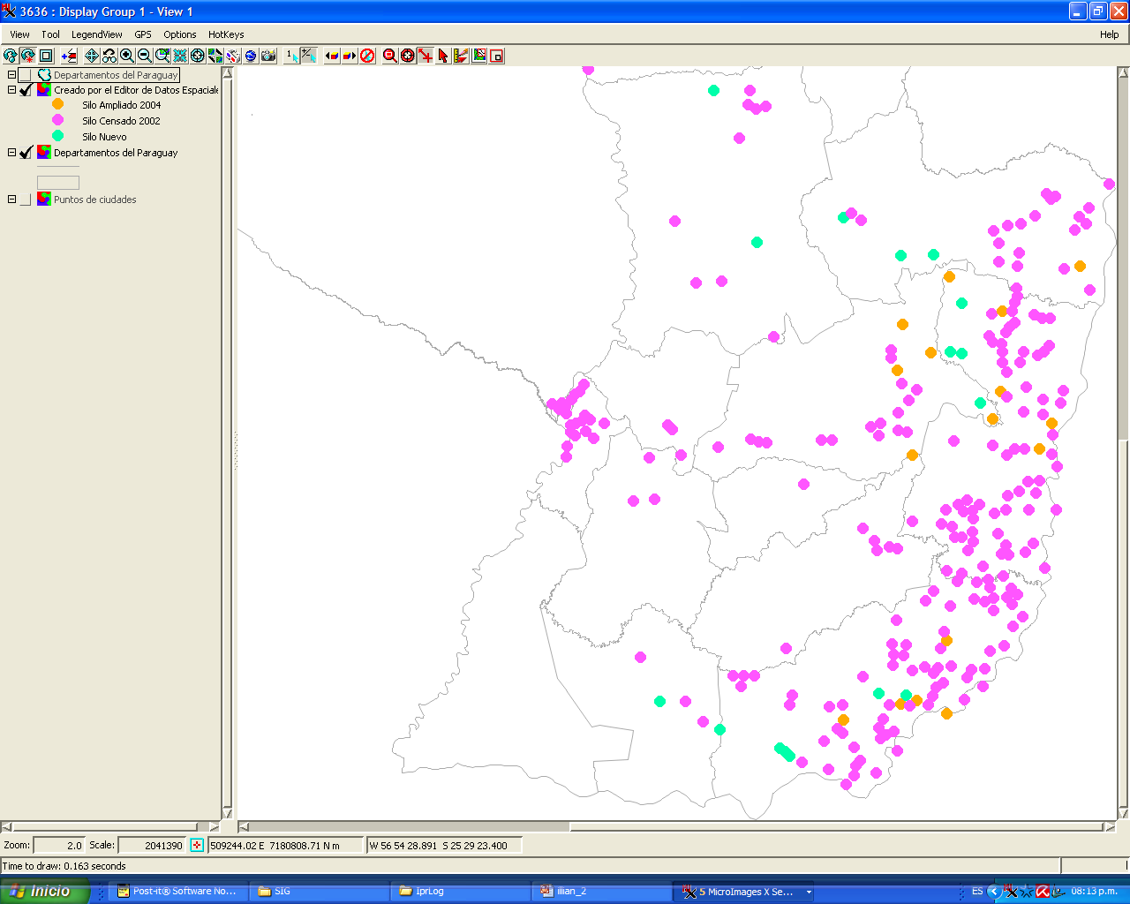
Business Opportunites
Soybean Complex
Beef Complex
Silo
Cold Chain Ports
Grains Ports
Meat Producers
Oil Factories
Meat Packing
Notes:
31

Slide 32
Business Opportunities
Private and Public Investments in road infrastructure.
Private and Public Investments in railroad transportation.
Private Investments for meat and grain storage.
Private Investments for meat packing.
Private Investments in river ports.
Private Investments in logistics for export.
Private Investments in river transportation systems.
Private Investments in Trade Logistics (certification, packing, financing, trading, others).
Notes:
32

Slide 33
OPPORTUNITIES
Reforestation
Notes:
33

Slide 34
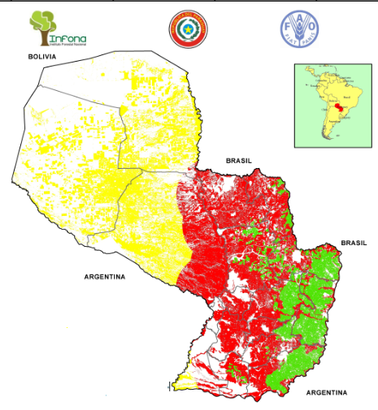
Reforestation
Forest Plantation
N° | DISTRICT | AREA (Has) | %
1 | ALTO PARANA | 10.361,46 | 19,61
2 | SAN PEDRO | 10.324,71 | 19,54
3 | CAAZAPA | 10.284,87 | 19,47
4 | ITAPUA | 5.163,07 | 9,77
5 | ÑEEMBUCU | 4.973,82 | 9,41
6 | CAAGUAZU | 3.922,62 | 7,43
7 | CANINDEYU | 3.019,16 | 5,71
8 | CONCEPCION | 1.464,63 | 2,77
9 | PARAGUARI | 733,86 | 1,39
10 | GUAIRA | 640,88 | 1,21
11 | CORDILLERA | 615,75 | 1,17
12 | MISIONES | 521,02 | 0,99
13 | AMAMBAY | 339,29 | 0,64
14 | PTE. HAYES | 320,91 | 0,61
15 | CENTRAL | 142,83 | 0,22
 | TOTAL | 52.828,88 | 100,00
N° | DEPARTMENT | AREA |  |  | TOTAL AREA
 |  | HIGH | MEDIUM | LOW
1 | CONCEPCION | 1.169.100,08 | - | 16.875,95 | 1.185.976,03
2 | SAN PEDRO | 1.162.693,51 | - | 269.356,00 | 1.432.049,51
3 | CORDILLERA | 266.494,58 | - | - | 266.494,58
4 | GUAIRA | 296.791,14 | - | 1.154,16 | 297.945,30
5 | CAAGUAZU | 582.821,39 | - | 456.450,15 | 1.039.271,54
6 | CAAZAPA | 483.818,37 | - | 152.287,59 | 636.105,96
7 | ITAPUA | 545.703,99 | - | 658.997,95 | 1.204.701,94
8 | MISIONES | 348.777,78 | - | 56.318,21 | 405.095,99
9 | PARAGUARI | 550.858,40 | - | - | 550.858,40
10 | ALTO PARANA | 218.608,83 | - | 921.903,08 | 1.140.511,91
11 | CENTRAL | 76.782,84 | - | - | 76.782,84
12 | ÑEEMBUCU | 206.601,06 | 129.087,88 | - | 335.688,94
13 | AMAMBAY | 808.448,53 | - | 134.175,28 | 942.623,81
14 | CANINDEYU | 541.229,06 | - | 576.397,24 | 1.117.626,30
15 | PTE. HAYES | 2.133.207,58 | 2.385.832,48 | - | 4.519.040,06
16 | BOQUERON | - | 2.594.240,62 | - | 2.594.240,62
17 | ALTO PARAGUAY | 41.123,55 | 2.219.552,73 | - | 2.260.676,28
 | TOTAL | 9.433.095,80 | 7.328.713,71 | 3.243.915,61 | 20.005.725,12
Alta
Media
Baja
Notes:
34

Slide 35
Reforestation
LOCAL MARKET
BRAZIL
URUGUAY
MARKETS
Source: FAO (www.fao.org)
Notes:
35

Slide 36
OPPORTUNITIES
Turism Regime ending in 2019
Notes:
36

Slide 37
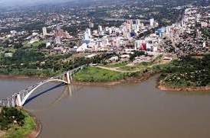
Border of Opportunities

Slide 38
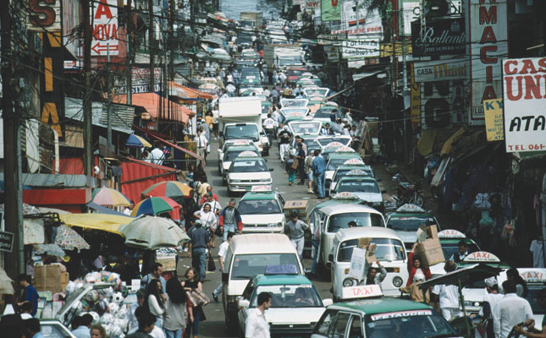
Borders today
Extra Zone imported products sold to citizens within the region, at competitive prices, through a tax exemption regime provided by Paraguay.

Slide 39
Borders - Visión
A world class center for production, distribution and retail of competitive goods, with national value added, and a safety destination for tourism.

Slide 40
Borders - Strategy
BUSINESS HUB
Production and distribution center
Shopping Center
Ciudad del Este, Salto de Guairá and Pedro Juan Caballero becoming a business node, profiting from the geographical location , within a cosmopolitan environment, with fiscal benefits and commercial know-how from experienced entreprenuers with more than 50 years in the market.

Slide 41
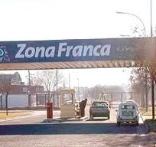
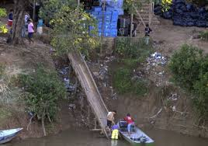
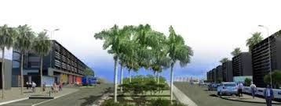
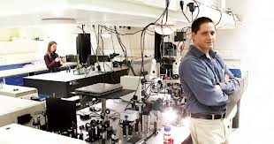
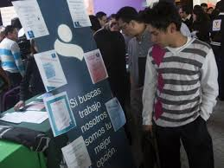
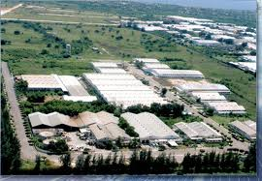
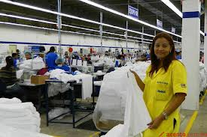
Fronteras 180º
Informal activities
FREE TRADE ZONE FOR MULTINATIONAL AUTOPARTS, TECHNOLOGY AND FINANCING SERVICES FOR MERCOSUR
WORLD CLASS TECHNOLOGY TRAINING CENTER
Silicon Border
Street vending
INDUSTRIAL PARKS INTEGRATED TO PRODUCTIVE VALUE ADDED CHAINS WITHIN MERCOSUR
WORLD CLASS TECHNOLOGY CENTER
Low cost/low margin

Slide 42
Business Opportunities
Labor Intensive companies taking advantage of the Free Trade Zone for installing industrial platforms.
The implementation of the High – Tech Assembly Act providing advantages for Labor Intensive Companies.
Preferential access to MERCOSUR through a List of Exemption for goods, as a driver to increase the competitivess of the industry.
Focus on Productive Chain Integration with Brazilian companies to take advantage of existing markets.
Industrial Parks promoting the instalation of Food Service, Financing and Logistics companies.
Notes:
42

Slide 43
OPPINION OF INTN´L COMPANIES
Notes:
43

Slide 44
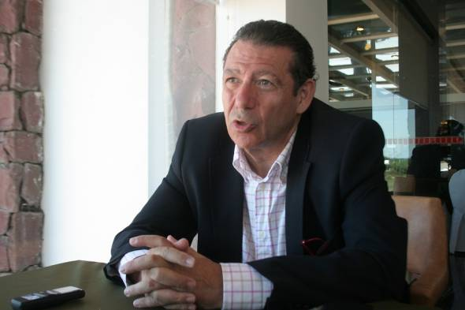
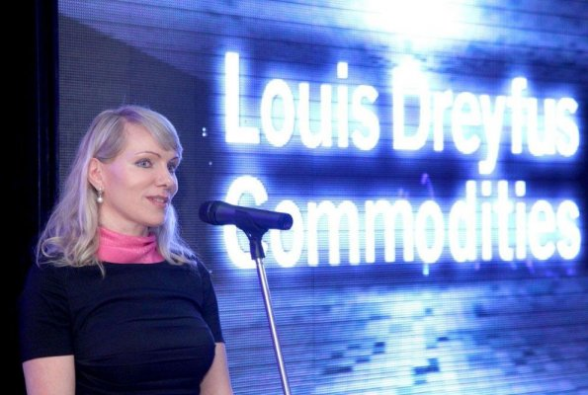
“Paraguay has major advantages for investments and logistics. The triple border region of extraordinary is an excelent platform for exports and imports ¨
(Ignacio Ibarra – President of Fujikura Automotive Paraguay)
¨ Our group in making significant investments in Paraguay, and will increasing the production of seeds and grains. We believe the future of the country is promising
(Margarita Louis Dreyfus – President of Louis Dreyfus Commodities)
“The strategically location of our complex in Villeta allows a complete integration of our logistics
(Juan Luciano – CEO - ADM)
Notes:
44

Slide 45
¨ We are very pleased with the results, we have found full cooperation of the Government of Paraguay. We estimate an annual production of 100 barges ¨
(Nobuaki Fujii – President of Tsuneishi Paraguay)
¨ In Paraguay we found the perfect conditions for investments, in terms of workforce and costs, specifically in the shipping industry¨
(Jens Keiner – Imperial Shipping Group)
Notes:
45

Slide 46
Thank you
Notes:
46
46

